Slide 1
The Value Chain vs. The Real-World Organization
The value chain describes a linear pathway that information follows from event to action
However, real organizations are not constructed around information alone:
Functional (Marketing, Finance), Customer Group (Business vs. Consumer), Line of Business (Generators, Shop Tools), etc.
Various flavors of specialized skills or knowledge
There is a general tension and trade-off between technical skills and contextual acumen
Resources with more technical skill tend to do the ‘heavy lifting’
Resources with more context tend to interpret and make decisions
Where analytics are concerned, organizations tend to focus on broad activity classes and the types of outputs produced

Slide 2
Analytical Activities – A Simple Lexicon
C R E A T I V I T Y
Data Architecture
Overall design of the data environment to serve the needs of the enterprise
Data Management
Building & maintaining the data environment
Reporting
Standardized, periodic renderings of specific metrics or data relationships
Ad-Hoc
Analysis
Directed analysis to answer a specific question; if same thing done repeatedly, should be reporting
Data Mining
Modeling
Advanced analysis or application of data using higher-order techniques

Slide 3


Analytical Organizations – Who Does What?
Highly Technical “IT” Support Functions
Infrastructure – Typically manages the physical hardware and connections inside and outside the company
Almost always in an IT organization
Source system / application development & administration – Builds & manages systems that capture front-line information
Almost always in an IT or Software development organization
May also include support of ancillary functionality like Corporate IT

Slide 4

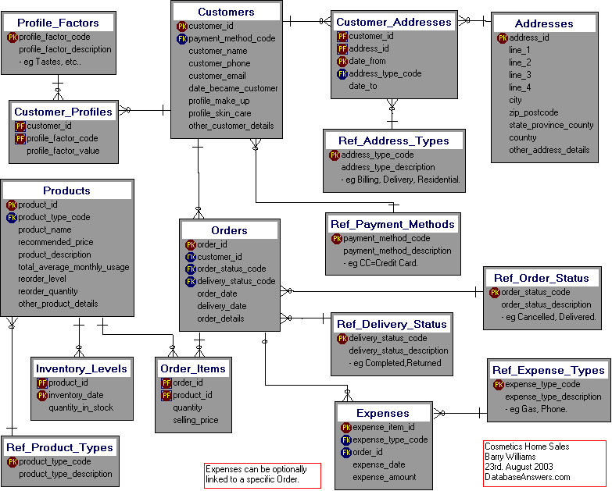

Analytical Organizations – Who Does What?
Technical Database & BI Management Functions
Data Architect – Designs and structures the databases in which information is to be stored
Usually in an IT organization
Database Administrator – Manages the creation and maintenance of databases, as well as access, stability, and efficiency
Usually in an IT organization, often in a data warehousing team
ETL Developer – Implements the Extract, Transform, and Load logic that populates databases
Usually in a data warehousing team within an IT organization
BI Developer – More loosely defined, but generally administers more technical maintenance & development functions for a Business Intelligence toolset
Usually in a data warehousing or BI team within an IT organization

Slide 5


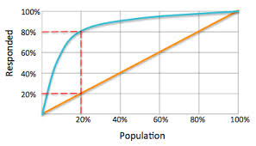
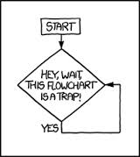
Analytical Organizations – Who Does What?
Data Manipulation and Analysis Functions
Database Analyst – Extracts and analyzes data, usually by directly accessing one or more databases
Sometimes in IT, sometimes in ‘the business’
Data Analyst – Analyzes data; may not access database directly, and often has more business context
Usually in a business / functional team
Modeler – Uses advanced techniques, including statistical modeling, to reveal insights and make predictions
Usually in a business / functional team
Business Analyst – May use data, but more directed at understanding business processes and how things work
Can be anywhere

Slide 6
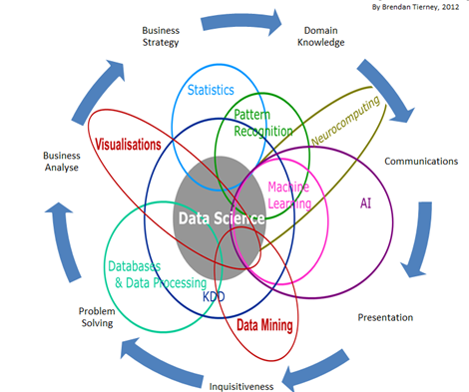
Analytical Organizations – Who Does What?
Data Manipulation and Analysis Functions
The “DATA SCIENTIST”
Reflects blurring of roles
Has broad skill set
Has context
Applies scientific approach
Is a master communicator

Slide 7
Recap
Organized around functions, customer groups, lines of business
Activity Classes:
Data Architecture
Data Management
Reporting
Ad-Hoc Analytics
Modeling
Roles:
Highly Technical IT & Support Roles
Technical Data Management & BI Roles
Data Manipulation & Analysis Roles
Multidimensional role of Data Scientist

